Slide 1
Assignment-1 (Inhabitant term prediction)
23M0837 Ujjwal Sharma CSE
23M0753 Swapnil Bhattacharyya CSE
23M0834 Priyanshu Sharma CSE
23D0373 Priya Mishra CSE

Slide 2
Problem Statement (1/2)
Inhabitants of different cities are often associated with specific terms that reflect their connection to their place of residence.
Your task is to create a predictive model that can determine the correct inhabitant term for a new city. By analyzing existing data on city-inhabitant relationships, you will develop an understanding of the patterns and linguistic rules that govern these terms.
You are encouraged to leverage various methods, such as traditional rule-based approaches, classical machine learning techniques, or even deep learning methods, to accomplish this prediction task.

Slide 3
Problem Statement (2/2)
Data collection: Collect/Create data of city/town/village vs. inhabitant-term. Create train, validation and test splits
Input: A city/place name: London
Output: Inhabitant term: Londoner
You will have to report on the validation and test data:
Accuracy
Perform detailed error analysis

Slide 4
Working with Data
Pre-processing
We have done stemming, manual alphabet correction, outlier removal and made classes out of the same.
Data Scraping: We have scraped data from Wikipedia, chatgpt and other websites.
Vocabulary size: Pre-filtration-1700+,Post-filtration 1171
Distribution for the classes is
{'ite': 56, 'n': 88, 'er': 220, 'nese': 18, 'ian': 147, 'an': 90, 'i': 76, 'ese': 49, 'nian': 11, 'is': 35, 'ns': 157, 'ans': 51, 'ians': 69, 'ites': 53, 'nians': 11, 'ers': 40}
Train, Test and Validation Split : 936, 141, 94 respectively

Slide 5
Experimental Setup
For solving this city-inhabitant problem we have experimented on a variety of classifiers ranging from classical machine learning models such as SVM, decision tree etc. , deep learning techniques such as feedforward neural networks and even rule based analysis
Predicted the classes ( suffixes ) based on the city name that is encoded into a vector.
A learning rate of 0.09 was used in the deep learning-based model.Models were trained for 100 epochs. We also tried different optimizers like Adam , SGD etc..
Detailed model architecture:
For ML based:- Decision trees, random forests, Naive Bayes, SVM were used.
For deep learning based models:-A feedforward neural network with one hidden layer,one input and one output layer was used.Adam was used as optimiser
We also did ensemble of all the above models ( majority vote )

Slide 6
Results
Model | Train Accuracy (in%) | Test and Validation Accuracy (in%) | Precision on Test And Validation (in%) | Recall on Test and Validation (in%) | F1-score on Test and Validation (in%)
Feed-Forward NN | 58.86 | 29.78 / 35.10 | 38.97 / 28.33 | 59.09 / 36.17 | 46.79 / 30.98
Decision Tree | 87.26 | 20.56 / 28.72 | 21.56 / 29.37 | 20.56 / 28.73 | 20.67 / 27.34
Random Forest ( 3 estimators ) | 72.97 | 12.76 / 14.89 | 34.26 / 33.57 | 12.76 / 14.89 | 18.26 / 19.90
Naïve Bayes | 46.47 | 31.91 / 36.97 | 18.32 / 34.48 | 31.91 / 36.17 | 22.72 / 31.52
SVM ( rbf kernel ) | 70.94 | 34.04 / 34.04 | 23.51 / 27.56 | 34.04 / 34.04 | 27.12 / 28.41
Ensemble method | 74.35 | 32.62 / 36.17 | 35.09 / 28.38 | 32.62 / 36.17 | 27.70 / 30.42

Slide 7
Analysis
Changing the optimiser from Adam to SGD and loss to MSE caused drastic change in test_accuracy (92%) but train and validation accuracy were as low as 12%
Although various models have been used the test and validation accuracy is much below 50 percent
Data cleaning and filtration was a tedious task considering unavailability of proper datasets
Rule Based analysis gave an accuracy of 19.81%
Having implemented a deep learning based feed-forward neural network and 5 ML based models,we obtained the highest accuracy on ensemble method ( Majority voting amongst all 5 models )

Slide 8
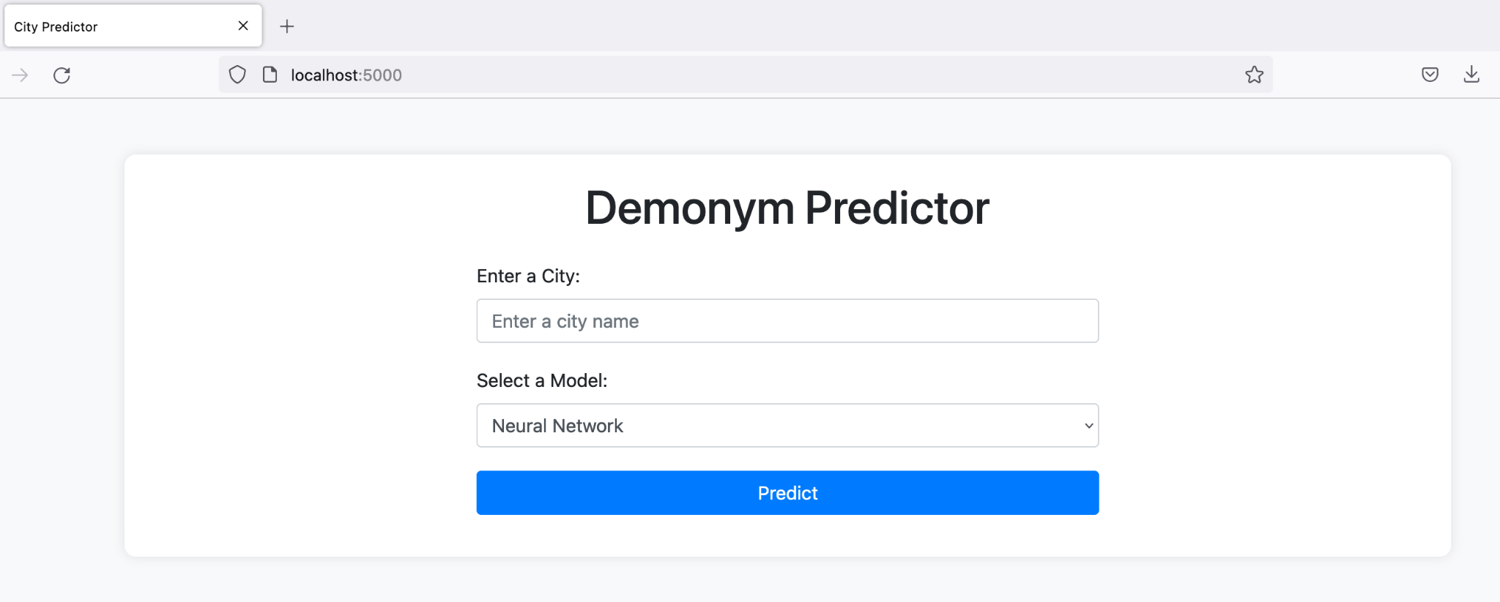
Demo
Demo ( both notebook and python script (for i/f))
Web Interface ( both Front End and Back End )

Slide 9
THANKS
Colab Link:
https://colab.research.google.com/drive/1316XLBVOHQtmL_tj_JQ5yzIU_xbBe9O7?usp=drive_link
Code ( with interface )
https://drive.google.com/file/d/1_yG2q0F4H84OjGWM04kHbdaUfBBJBll1/view?usp=drive_link

Slide 10
Marking
Data collection, curation and refinement (at least 500 cities) – 25 marks
Model(s) – 15 marks
Analysis – 10 marks
Demo – 10 marks
Overall impression – 10 marks
Interface – 10 marks
Accuracy
Above 80% - 10 marks
60-80% - 7 marks
40-60% - 5 marks
20-40% - 3 marks
Below 20 – 0 marks

Slide 11
Methodology: 2
We attempted to formulate rules for predicting citizen names.
After cleaning the dataset, excluding the wrong pairs, non-ASCII characters etc
The longest common subsequence evaluated between city and citizen name is detected.
Which is subtracted from both the city name and citizen name to have a base suffix and inflected suffix respectively.

Slide 12
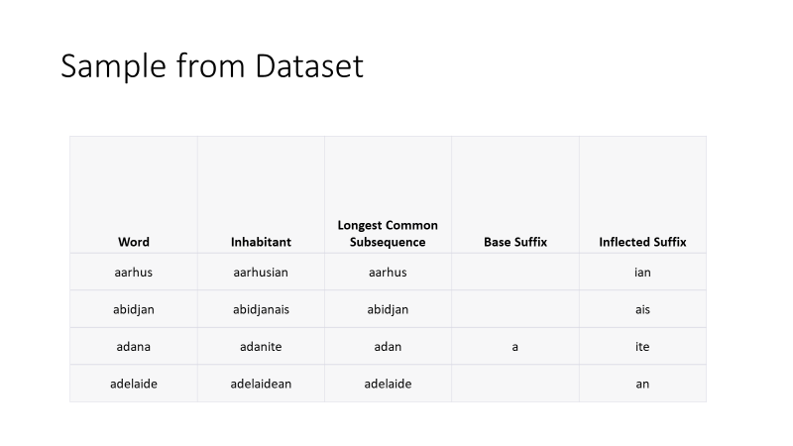
Sample from Dataset

Slide 13
Rule-based Approach vs. Machine Learning
Initially, we attempted to create rules for citizen name prediction.
However, this proved to be challenging due to the complexity of the problem.
Machine Learning to the Rescue
To overcome the challenges of rule-based prediction, we turned to machine learning.
We trained machine learning classifiers to learn the underlying patterns in the data.

Slide 14
Leveraging Character-Level N-Grams
To vectorize city names effectively, we employed character-level n-grams.
We computed TF-IDF (Term Frequency-Inverse Document Frequency) values for each character sequence within the n-gram range (2 to 4).

Slide 15
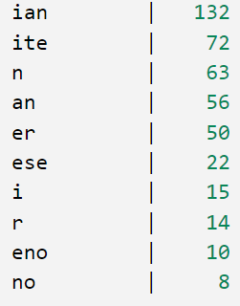
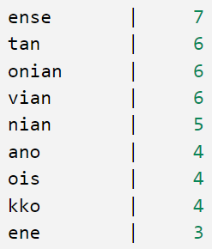
Inflected Suffix Frequency

Slide 16
- Our classes correspond to the inflected suffixes identified earlier, totaling 162 distinct classes.
- Many of these classes have limited samples, some even having just a single instance.
- We performed Leave-One-Out Cross-Validation (LOOCV) on all classes containing more than two samples.
- LOOCV is a robust validation technique that helps us assess our model's performance accurately.

Slide 17
LOOCV Results
SVM linear kernal
Mean Accuracy: 33.21%
Mean Micro-Average Precision: 33.21%
Mean Micro-Average Recall: 33.21%

Slide 18
- We reduced the number of classes to nine by filtering for inflected suffixes with a count of ten or more instances.
- This filtering ensured that each selected class had a substantial sample size, enhancing the robustness of our analysis.
- As a result, we were left with a total of 434 instances in these nine classes.
- This reduction in the number of classes allowed us to focus on more significant patterns and improve the overall reliability of our model.

Slide 19
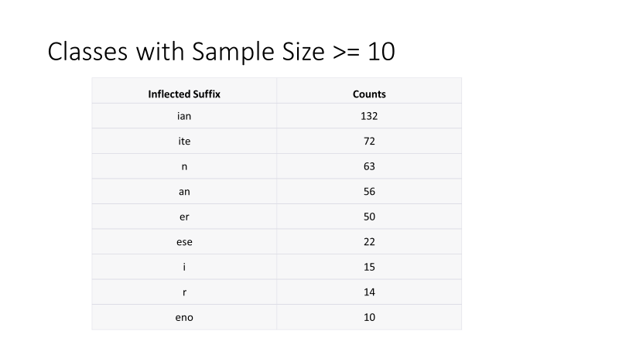
Classes with Sample Size >= 10

Slide 20
Train Results (Samples > 8)
Classifier | Accuracy | Weighted-Avg Precision | Weighted-Avg Recall | Weighted-Avg F1-Score
SVC | 0.9712 | 0.9732 | 0.9712 | 0.9709
MLPClassifier | 0.9452 | 0.9150 | 0.9452 | 0.9264
SGDClassifier | 0.9942 | 0.9943 | 0.9942 | 0.9942
DecisionTreeClassifier | 0.9942 | 0.9944 | 0.9942 | 0.9943
RandomForestClassifier | 0.9942 | 0.9944 | 0.9942 | 0.9942
XGBClassifier | 0.9914 | 0.9918 | 0.9914 | 0.9914
BaggingClassifier (SVM) | 0.7983 | 0.8712 | 0.7983 | 0.8004
BaggingClassifier (DT) | 0.9366 | 0.9389 | 0.9366 | 0.9368

Slide 21
Test Results (Samples > 8)
Model | Accuracy | Weighted-Avg Precision | Weighted-Avg Recall | Weighted-Avg F1-Score
SVM Linear Kernel | 34.48% | 40.66% | 34.48% | 26.92%
MLPClassifier | 29.89% | 31.00% | 29.89% | 28.66%
SGDClassifier | 37.93% | 38.36% | 37.93% | 33.04%
DecisionTreeClassifier | 41.38% | 44.38% | 41.38% | 39.43%
BaggingClassifier (SVM) | 29.89% | 39.42% | 29.89% | 17.59%
BaggingClassifier (DT) | 36.78% | 36.24% | 36.78% | 33.28%
RandomForestClassifier | 42.53% | 60.16% | 42.53% | 37.88%
XGBClassifier | 43.68% | 46.18% | 43.68% | 41.43%

Slide 22
Following the prediction of inflected suffixes, we proceed to match them with the corresponding base suffixes.
This matching step involves associating the base suffix with the city name.
Subsequently, the base suffix is subtracted from the city name to add the inflected suffix, resulting in the generation of the citizen name.
This sequential process enables us to construct citizen names with accurate inflected suffixes based on the city names.

